Slide 1
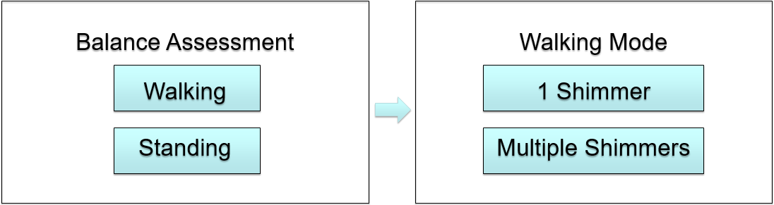

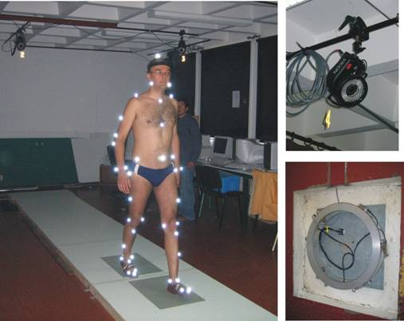
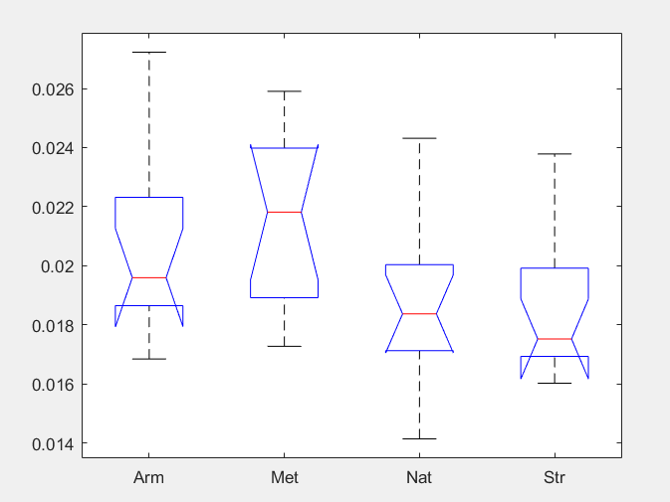
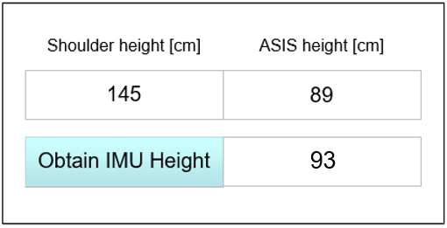
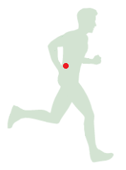
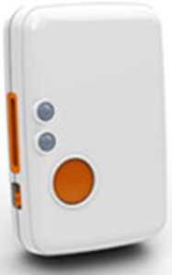
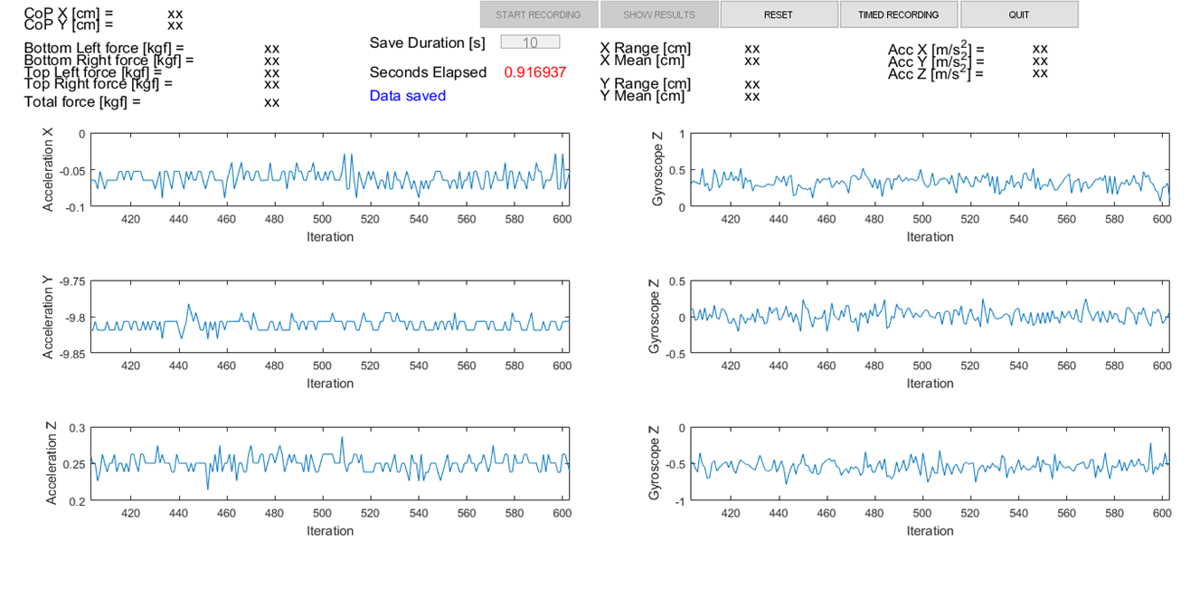
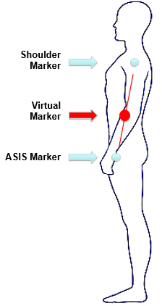

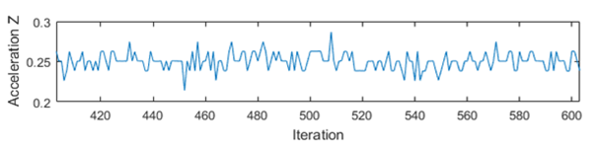
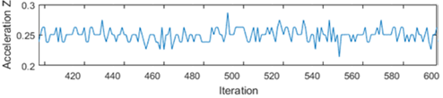
Development of a Clinically Usable Assessment Tool for Walking Balance
Tony Kung¹, Ray Fang¹, Jaeeun Yoo^{1,3}, Masahiro Shinya², Matija Milosevic², and Kei Masani^{1,3}
Rehabilitation Engineering Laboratory | IBBME | University of Toronto
Department of Life Sciences | Graduate School of Arts and Science, University of Tokyo
3) Rehabilitation Engineering Laboratory | Toronto Rehab | UHN
Purpose
Best Parameter to Differentiate COM Motion
Clinically Usable Assessment Tool
- To identify the optimal parameter and location for IMU analysis to estimate the COM action during walking
- To develop a low-cost clinically usable assessment tool for walking balance.
*0.860
*0.944
*0.693
The system integrates a commercially available, low-cost force plate (Wii Balance Board, Nintendo Inc.) and an IMU (Shimmer3, Shimmer Inc.) Using MATLAB, Shimmer API, WiiLab library [2], and other open source software
< Start Up View >
< Walking Mode View >
Background
*0.5586
*0.0005
*0.018
Assessments of walking balance are critically important for providing adequate therapies and predicting risks of falls to avoid incidents
Gait analyses using motion capture systems is accurate but they are not easily usable in clinical setting, i.e., they are time consuming and require a lot of setup to administer
*0.965
*0.078
*0.116
* = p values from One way Anova
The output given is 7.5% above the ASIS marker, as found in the previous results
Comparing the COM displacement, velocity and acceleration between the four conditions, differences were found only in velocity and acceleration. With conditions (STR) and (MET) showing a statistical difference in acceleration in the anterior-posterior (AP) direction.
< Data Collection View >
Box plot from Anova test of AP acceleration
Motion Capture Setup
Reduced markers to single IMU
Optimal Location for IMU Placement
Experimental Identification of Optimal Parameter/Location for IMU
ASIS and shoulder marker were used to describe the COM height
Three methods were compared:
1. Multiple Regression analysis using shoulder and ASIS to approximate COM location
2. RMS of COMz
3. RMS ratio of projected 3D COM (d1/d2)
14 subjects
Four walking conditions:
1. Natural (NAT), 2. Arms restricted (ARM),
3. Metronome (MET), 4. Stroop test (STR)
Motion Capturing (Oqus, Qualysis Inc.), 21 markers
Analyses:
Finding the best parameter summarizing the COM motion that differentiate 4 conditions
Finding the best location for IMU that can represent the COM movement, using the marker data
d1
d2
1
The Multiple regression method gave an approximate formula
CoMz ~ 2406.8 – 1.1113 x Shoulder – 2.6133 x Asis + 0.0019 x Asis x Shoulder
Method 2 calculated the height to be 20cm above the ASIS marker but did not take into account AP and ML directions
Method 3 took into account all directions and found the optimal location to be 7.5% above ASIS
Save and calculate walking parameters/results
< Data Analysis View >
Results
Average Stride Length: XX [m]
Walking Speed: XX [m/s]
Average X Acceleration:
Left
Right
2
3
Average Y Acceleration:
Average Z Acceleration:
Conclusion
Proposed three methods for the IMU optimal location, that can be easily used by clinicians
Developed a low cost, clinically usable system for gait assessment using Wii Fit Balance Board and Shimmer IMUs
This tool will provide clinicians with a more simple and affordable alternative for assessing walking balance.
Example trace of medio-lateral COM displacement, velocity and acceleration during NAT
The optimum location to place the IMU was found to be at 7.5% above the ASIS marker. The methods were compared by graphing the Actual vs Estimate and checking the spread of the graphs.
Rehabilitation Engineering Laboratory
Institute of Biomaterials and Biomedical Engineering
University of Toronto
Toronto Rehabilitation Institute | University Health Network
Contact: k.masani@utoronto.ca
www.toronto-fes.ca
8/15/2017
References
[1] Motion Capture. Digital image. Quantitative Biomechanical Analysis of Biped Locomotion – Capture of Human Motion. Robotics Laboratory, n.d. Web.
[2] netscale.cse.nd.edu/twiki/bin/view/Edu/WiiMote
[3] Wii Balance Board Project , University of Colarado. http://www.colorado.edu/neuromechanics/research/wii-balance-board-project
8/15/2017

